Slide 1
DATA STRUCTURES FOR ALGORITHMIC EFFICIENCY
BY KARTHIK SUBRAMANIAN

Slide 2
Data Structures for Algorithmic Efficiency
There are some advanced data structures that provide efficient solutions to maintain and access data making them for efficient in terms of algorithmic complexity.
It enables easy traversal of elements or improvised search making them more efficient in searching and modifying.
Trees, graphs and Hash tables are examples of such data structures.

Slide 3
Tree- Data Structure
A tree data structure is a hierarchical data structure making navigation and search of data easier.
It is a collection of nodes that are connected by edges and has a hierarchical relationship between the nodes.
The topmost node is called the root node and the nodes under it are called child nodes.

Slide 4
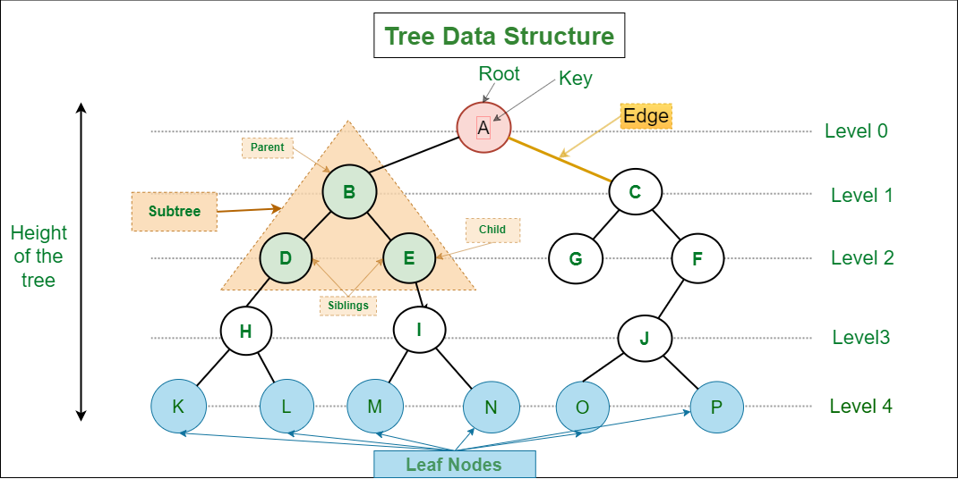
Tree- Data Structure

Slide 5
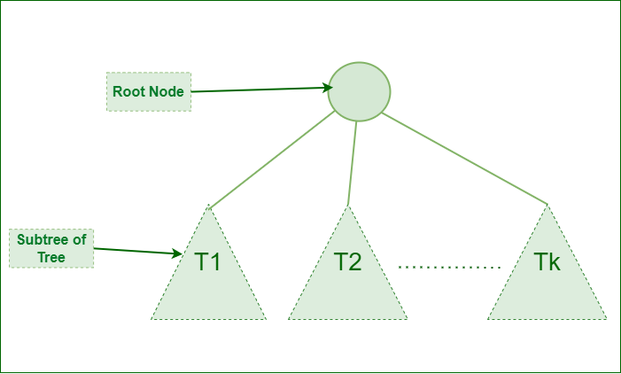
Tree -Recursive data structure
struct Node { int data; struct Node *first_child; struct Node *second_child; struct Node *third_child; . . . struct Node *nth_child; };

Slide 6
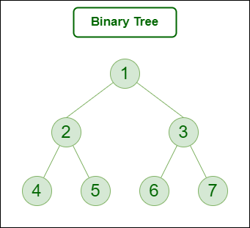
Tree - Binary Tree
A binary tree is one where each node can have a maximum of 2 child nodes.
In the example diagram on the left:
Node 1 is the root node
1 is the parent of 2 and 3
2 and 3 are the siblings
4, 5, 6, and 7 are the leaf nodes
1 and 2 are the ancestors of 5

Slide 7
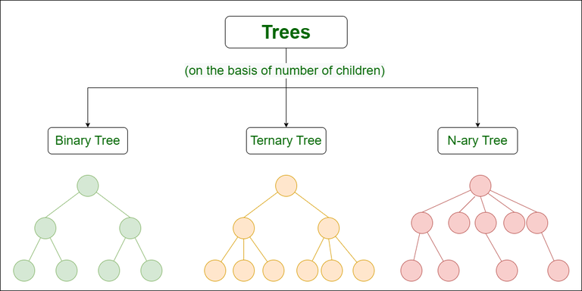
Types of trees

Slide 8
Graphs
Graph Data Structure is a collection of nodes connected by edges.
It’s used to represent relationships between different entities. Graph algorithms are methods used to manipulate and analyze graphs, solving various problems like finding the shortest path or detecting cycles.
Graph is a non-linear data structure consisting of vertices and edges. The vertices are sometimes also referred to as nodes and the edges are lines or arcs that connect any two nodes in the graph.
More formally a Graph is composed of a set of vertices( V ) and a set of edges( E ). The graph is denoted by G(V, E).

Slide 9
Graphs - Data structure representation
Graph can be represented in the following ways:
Set Representation: Set representation of a graph involves two sets: Set of vertices V = {V₁, V₂, V₃, V₄} and set of edges E = {{V₁, V₂}, {V₂, V₃}, {V₃, V₄}, {V₄, V₁}}. This representation is efficient for memory but does not allow parallel edges.
Sequential Representation: This representation of a graph can be represented by means of matrices: Adjacency Matrix, Incidence matrix and Path matrix.
Adjacency Matrix: This matrix includes information about the adjacent nodes. Here, a_{ij} = 1 if there is an edge from V_{i} to V_{j} otherwise 0. It is a matrix of order V×V.
Incidence Matrix: This matrix includes information about the incidence of edges on the nodes. Here, a_{ij} = 1 if the j^{th} edge E_{j} is incident on i^{th} vertex V_{i} otherwise 0. It is a matrix of order V×E.
Path Matrix: This matrix includes information about the simple path between two vertices. Here, P_{ij} = 1 if there is a path from V_{i} to V_{j} otherwise 0. It is also called as reachability matrix of graph G.

Slide 10
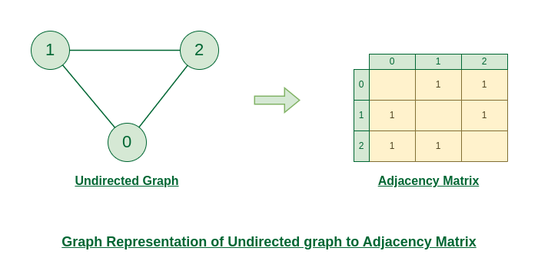
Undirected Graphs- representation
The figure shows an undirected graph. Initially, the entire Matrix is ​​initialized to 0.
If there is an edge from source to destination, we insert 1 to both cases (adjMat[destination] and adjMat[destination]) because we can go either way.

Slide 11
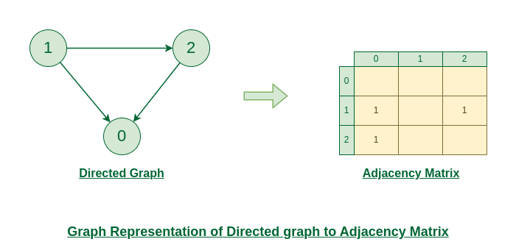
Directed graphs - representation
The figure shows a directed graph.
Initially, the entire Matrix is ​​initialized to 0.
If there is an edge from source to destination, we insert 1 for that particular adjMat[destination].

Slide 12
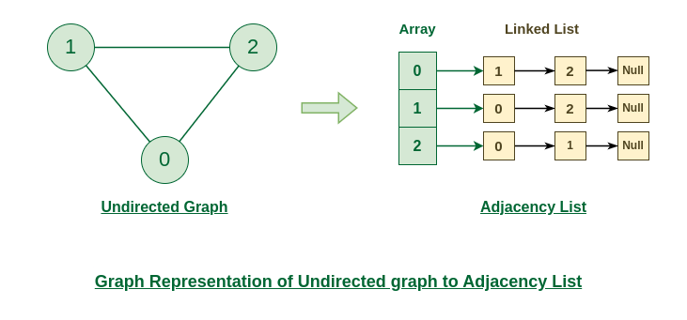
Undirected graphs to adjacency list

Slide 13
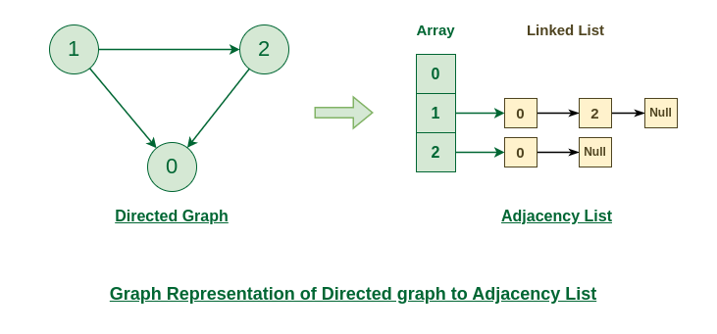
Directed graphs to Adjacency List

Slide 14
Hash Tables
Hash Table in Data Structure
A hash table is also known as a hash map. It is a data structure that stores key-value pairs.
It uses a hash function to map keys to a fixed-size array, called a hash table. This allows in faster search, insertion, and deletion operations.

Slide 15
Hash Table - Data structure
Hash tables are stored in the following formats of data:
The hash function is a function that takes a key and returns an index into the hash table. The goal of a hash function is to distribute keys evenly across the hash table, minimizing collisions (when two keys map to the same index).
Common hash functions include:
Division Method: Key % Hash Table Size
Multiplication Method: (Key * Constant) % Hash Table Size
Universal Hashing: A family of hash functions designed to minimize collisions

Slide 16
Hash Table in C
The following code shows a simple hash table data structure in C with key value pair in a struct.
The key is of type char pointer and value is of type integer.
The hash table can have functions to insert, delete and update records.
The hash table can be stored in sorted or unsorted manner. If sorted, binary search can be used to insert, update or retrieve data.
typedef struct {
char* key;
int value;
} item;

Slide 17
APPLICATIONS OF THESE DATA STRUCTURES

Slide 18
Application of tree data structure
Applications of Tree Data Structure:
File System: This allows for efficient navigation and organization of files.
Data Compression: Huffman coding is a popular technique for data compression that involves constructing a binary tree where the leaves represent characters and their frequency of occurrence. The resulting tree is used to encode the data in a way that minimizes the amount of storage required.
Compiler Design: In compiler design, a syntax tree is used to represent the structure of a program.
Database Indexing: B-trees and other tree structures are used in database indexing to efficiently search for and retrieve data.

Slide 19
Graphs - Application
Social media analysis: Social media platforms generate vast amounts of data in real-time, which can be analyzed using graphs to identify trends, sentiment, and key influencers. This can be useful for marketing, customer service, and reputation management.
Network monitoring: Graphs can be used to monitor network traffic in real-time, allowing network administrators to identify potential bottlenecks, security threats, and other issues. This is critical for ensuring the smooth operation of complex networks.
Financial trading: Graphs can be used to analyze real-time financial data, such as stock prices and market trends, to identify patterns and make trading decisions. This is particularly important for high-frequency trading, where even small delays can have a significant impact on profits.
Internet of Things (IoT) management: IoT devices generate vast amounts of data in real-time, which can be analyzed using graphs to identify patterns, optimize performance, and detect anomalies. This is important for managing large-scale IoT deployments.
Autonomous vehicles: Graphs can be used to model the real-time environment around autonomous vehicles, allowing them to navigate safely and efficiently. This requires real-time data from sensors and other sources, which can be processed using graph algorithms.
Disease surveillance: Graphs can be used to model the spread of infectious diseases in real-time, allowing health officials to identify outbreaks and implement effective containment strategies. This is particularly important during pandemics or other public health emergencies.
The best example of graphs in the real world is Facebook. Each person on Facebook is a node and is connected through edges. Thus, A is a friend of B. B is a friend of C, and so on.

Slide 20
Hash table - Application
Hash tables find widespread use in many applications. Examples are:
Databases: Storing and retrieving data based on unique keys
Caching: Storing frequently accessed data for faster retrieval
Symbol Tables: Mapping identifiers to their values in programming languages
Network Routing: Determining the best path for data packets
A simple application would be to display the count of each word in a text file. Here the key would be the char buffer storing the word and the count is the integer value of this key.

